Slide 1
Particle Photon, Sparkfun Weather Shield and Microsoft Azure

Slide 2
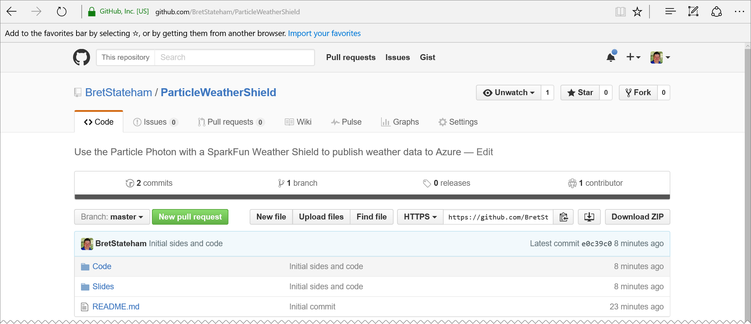
Github repo
DOWNLOAD FILES FROM http://aka.ms/pws

Slide 3
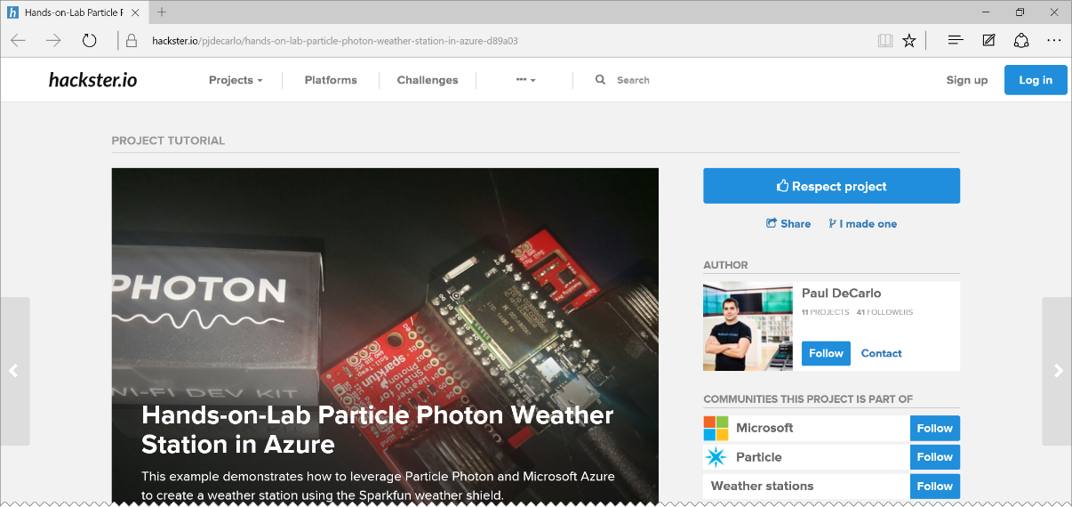
HANDS-ON-LAB WALKTHROUGH
http://aka.ms/pwshol
Go ahead and open it, but we’ll walk through it here.

Slide 4
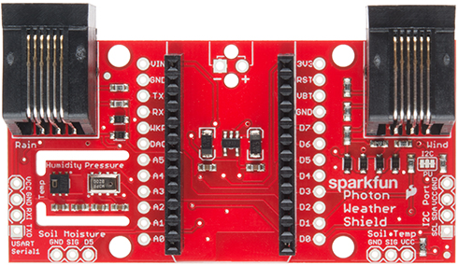
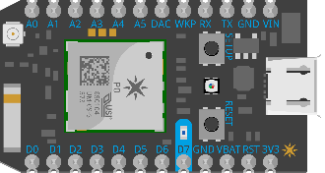
Architcture overview
You Configure These
Pre-Existing Services
connectthedotsex-ns Service Bus Namespace
SEND
SEND
ehdevices
Event Hub
RCV
connectthedotsdx
Web App
PublishToEventHub Webhook

Slide 5
Installing prerequisites

Slide 6
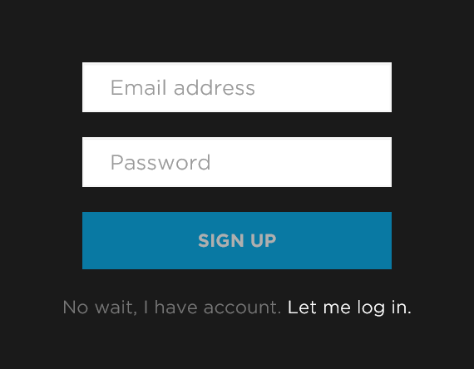
Create a free particle.io account
Go to http://particle.io
Click on the “build” link: http://build.particle.io/build
Create an account (free) make sure to remember the email/pwd used

Slide 7
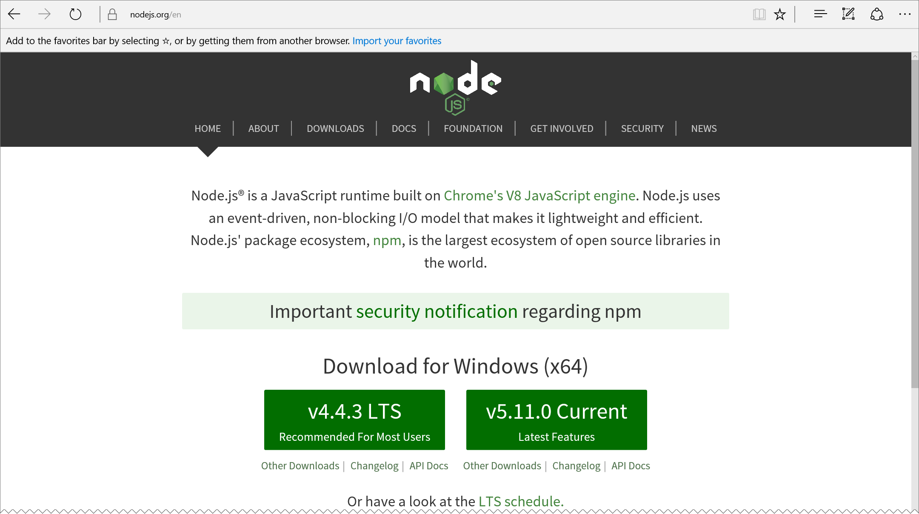
Install node.js
https://nodejs.org/

Slide 8
Install prerequisites
Install Node 0.12.4 (Yes, and older version) https://nodejs.org/download/release/v0.12.4/ Need a version manager for node? Check out https://github.com/creationix/nvm for Mac OSx or Linux or http://github.com/coreybutler/nvm-windows for Windows
Download and install Python 2.x (not 3+) https://www.python.org/downloads/
On Windows? You need Visual Studio C++ tools: http://aka.ms/msbuild2013
REBOOT AFTER

Slide 9
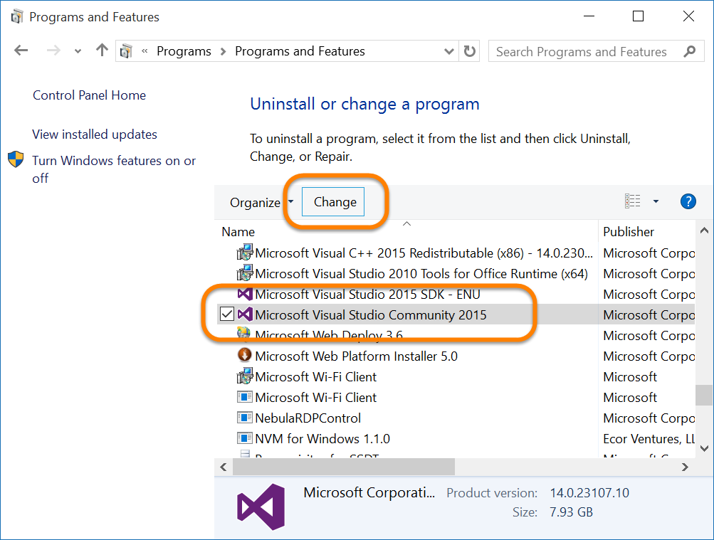
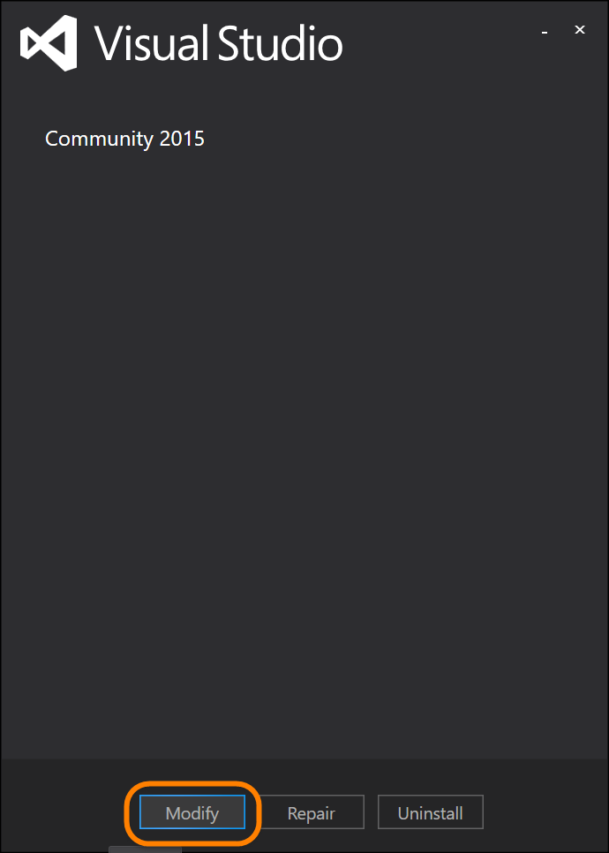
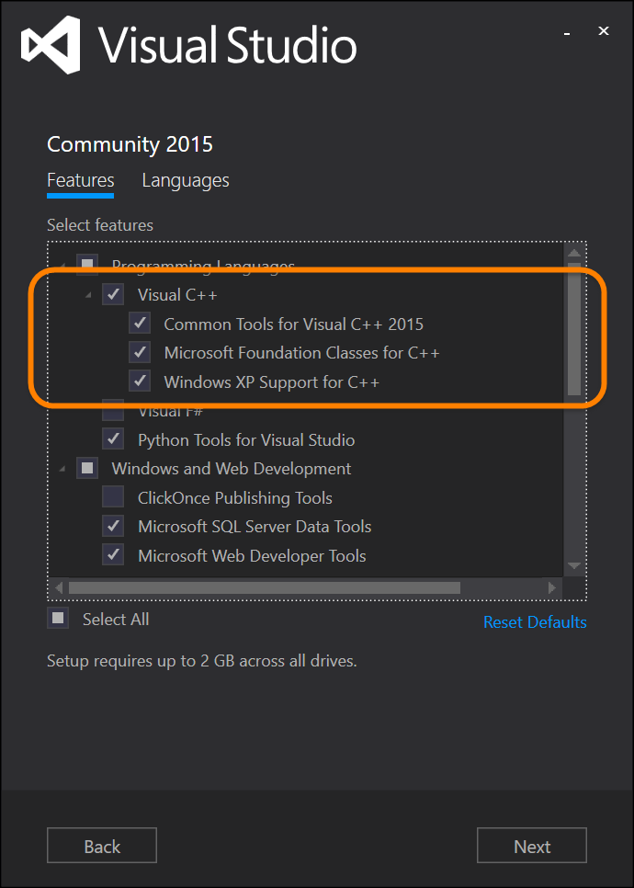
Windows C++ tools requirement
Already have VS installed, but not the C++ tools?
From “Control Panel” | “Programs” modify your VS install:

Slide 10
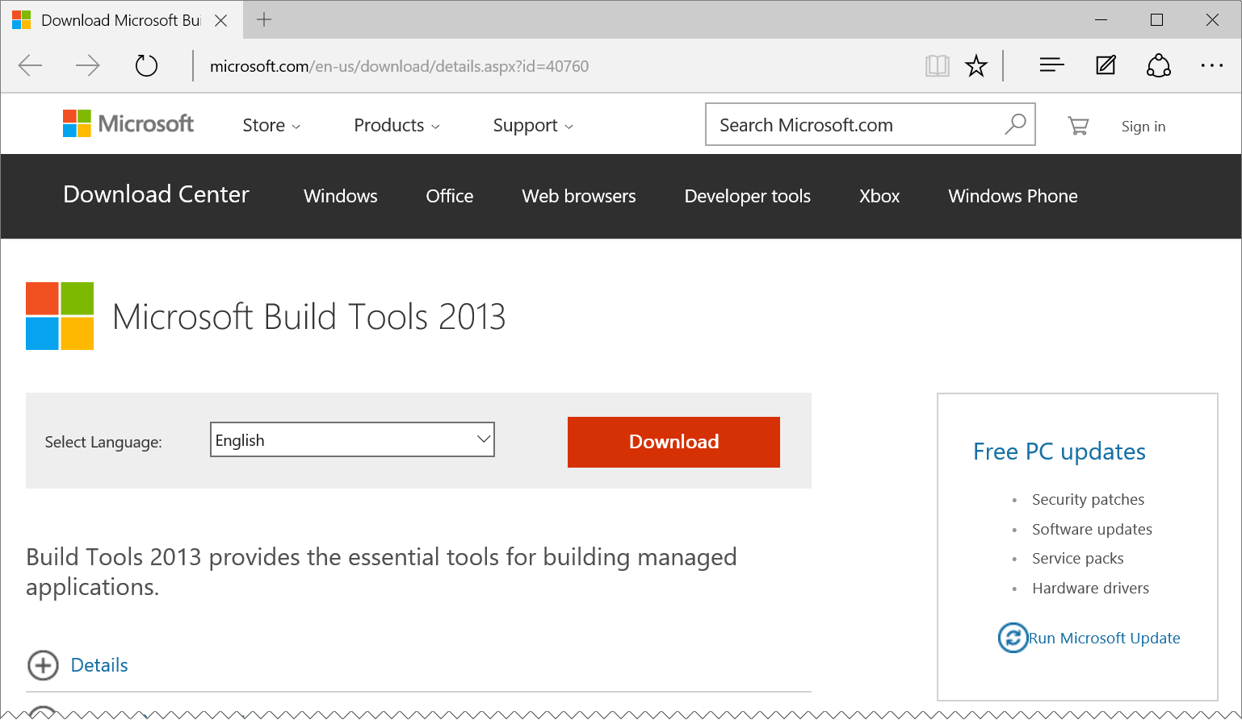
Windows C++ tools requirement
Don’t have Visual Studio installed?
Install MSBuild for VS2013: http://aka.ms/msbuild2013

Slide 11
Install the particle-cli
Windows: Open a command prompt
Mac: Open a terminal window (may need to use sudo)
npm install –g particle-cli

Slide 12
Install the particle-cli
npm install particle-cli -g
If it doesn’t build right on Windows, try adding:
npm install particle-cli –g --msvs_version=2013

Slide 13
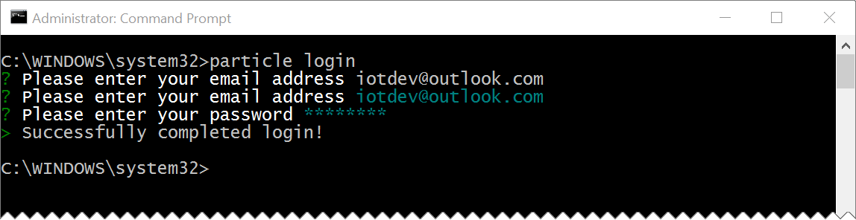
Login to the particle-cli
From a command prompt / terminal window: particle login
Use the credentials for particle build account you created

Slide 14
DOWNLOAD THE SOURCE
On Windows, “unblock” the .zip before you extract it:
Right-click on .zip
Select Properties
Check “unblock”
Click “OK”
DOWNLOAD FILES FROM http://aka.ms/pws

Slide 15
Setting up and claiming the photon

Slide 16
Assemble the photon and weather shield
Photon’s USB port on the same edge as the Rain and Wind sensor jacks

Slide 17
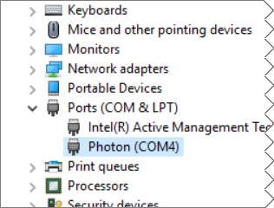
Connect the photon to your computer via usb cable
On Windows? Install the driver: http://aka.ms/photondriver
Extract the .zip file to a folder on your computer:
Open Device Manager
Right click-on the un-recognized device
Select “Update Driver Software…”
Point to the folder where you extracted the driver
Complete the install
Note the COM port it is attached to

Slide 18
Identify the attached photon
First find the COM port it is attached to: particle serial list
Then, get the device ID: particle serial identify
Copy the Photon ID to your clipboard and save somewhere for later

Slide 19
Configure the particle wifi
From the command prompt: particle serial wifi Follow the prompts to connect the WiFi: <your wifi ssid> <your wifi security mode> <your wifi cypher type> <your wifi password>

Slide 20
Claim and name your photon
Then, get the device ID, copy the reported ID to your clipboard (Make sure the Photon is in Listening Mode ): particle serial identify
Add the device to your account particle device add <id>
Name the device particle device rename <id> <newname>

Slide 21
Creating the webhook

Slide 22
Download the webhook.json
http://aka.ms/pwsholwebhook
Save it to a known folder on your computer
Open the webhook.json file to review it
YOU DO NOT NEED TO MAKE ANY CHANGES AT THIS POINT
Learn more about Particle Webhooks here: http://aka.ms/pwh

Slide 23
{
"event": "ConnectTheDots",
"url": "https://connectthedotsex-ns.servicebus.windows.net/ehdevices/messages",
"requestType": "POST",
"json": {
"subject": "{{s}}",
"unitofmeasure": "{{u}}",
"measurename": "{{m}}",
"value": "{{v}}",
"organization": "{{o}}",
"displayname": "{{d}}",
"location": "{{l}}",
"timecreated": "{{SPARK_PUBLISHED_AT}}",
"guid": "{{SPARK_CORE_ID}}"
},
"azure_sas_token": {
"key_name": "D1",
"key": "mBLQGWxSkRHg7f2eRCLonHUpNS+DY0iPHclxjf7Cmvk="
},
"mydevices": true
}

Slide 24
{
"event": "ConnectTheDots",
"url": "https://connectthedotsex-ns.servicebus.windows.net/ehdevices/messages",
"requestType": "POST",
"json": {
"subject": "{{s}}",
"unitofmeasure": "{{u}}",
"measurename": "{{m}}",
"value": "{{v}}",
"organization": "{{o}}",
"displayname": "{{d}}",
"location": "{{l}}",
"timecreated": "{{SPARK_PUBLISHED_AT}}",
"guid": "{{SPARK_CORE_ID}}"
},
"azure_sas_token": {
"key_name": "D1",
"key": "mBLQGWxSkRHg7f2eRCLonHUpNS+DY0iPHclxjf7Cmvk="
},
"mydevices": true
}
The name of the “event” that will invoke the webhook.
When you call Spark.publish("ConnectTheDots", payload); from your Photon, the Particle cloud back end will trigger this webhook and publish your payload to the Azure Event Hub, specified by the “url”

Slide 25
{
"event": "ConnectTheDots",
"url": "https://connectthedotsex-ns.servicebus.windows.net/ehdevices/messages",
"requestType": "POST",
"json": {
"subject": "{{s}}",
"unitofmeasure": "{{u}}",
"measurename": "{{m}}",
"value": "{{v}}",
"organization": "{{o}}",
"displayname": "{{d}}",
"location": "{{l}}",
"timecreated": "{{SPARK_PUBLISHED_AT}}",
"guid": "{{SPARK_CORE_ID}}"
},
"azure_sas_token": {
"key_name": "D1",
"key": "mBLQGWxSkRHg7f2eRCLonHUpNS+DY0iPHclxjf7Cmvk="
},
"mydevices": true
}
The “url” of the Azure Event Hub that the data will be published to.
In this case, we are posting to the “connectthedotsex-ns” service bus namespace into an event hub named “ehdevices”

Slide 26
{
"event": "ConnectTheDots",
"url": "https://connectthedotsex-ns.servicebus.windows.net/ehdevices/messages",
"requestType": "POST",
"json": {
"subject": "{{s}}",
"unitofmeasure": "{{u}}",
"measurename": "{{m}}",
"value": "{{v}}",
"organization": "{{o}}",
"displayname": "{{d}}",
"location": "{{l}}",
"timecreated": "{{SPARK_PUBLISHED_AT}}",
"guid": "{{SPARK_CORE_ID}}"
},
"azure_sas_token": {
"key_name": "D1",
"key": "mBLQGWxSkRHg7f2eRCLonHUpNS+DY0iPHclxjf7Cmvk="
},
"mydevices": true
}
The data will be sent to the url using an HTTP POST

Slide 27
{
"event": "ConnectTheDots",
"url": "https://connectthedotsex-ns.servicebus.windows.net/ehdevices/messages",
"requestType": "POST",
"json": {
"subject": "{{s}}",
"unitofmeasure": "{{u}}",
"measurename": "{{m}}",
"value": "{{v}}",
"organization": "{{o}}",
"displayname": "{{d}}",
"location": "{{l}}",
"timecreated": "{{SPARK_PUBLISHED_AT}}",
"guid": "{{SPARK_CORE_ID}}"
},
"azure_sas_token": {
"key_name": "D1",
"key": "mBLQGWxSkRHg7f2eRCLonHUpNS+DY0iPHclxjf7Cmvk="
},
"mydevices": true
}
The json template is used to create the data for the message that will be sent to the Azure Event Hub

Slide 28
{
"event": "ConnectTheDots",
"url": "https://connectthedotsex-ns.servicebus.windows.net/ehdevices/messages",
"requestType": "POST",
"json": {
"subject": "{{s}}",
"unitofmeasure": "{{u}}",
"measurename": "{{m}}",
"value": "{{v}}",
"organization": "{{o}}",
"displayname": "{{d}}",
"location": "{{l}}",
"timecreated": "{{SPARK_PUBLISHED_AT}}",
"guid": "{{SPARK_CORE_ID}}"
},
"azure_sas_token": {
"key_name": "D1",
"key": "mBLQGWxSkRHg7f2eRCLonHUpNS+DY0iPHclxjf7Cmvk="
},
"mydevices": true
}
{
“s”: ”Weather”,
“u”: “F”,
“m”: “Temperature”,
“v”: 79.234,
“o”: “My Organization”,
“d”: “My Device Name” “l”: “My Location”,
} Sample Payload from the Photon’s Particle.Publish() call

Slide 29
{
"event": "ConnectTheDots",
"url": "https://connectthedotsex-ns.servicebus.windows.net/ehdevices/messages",
"requestType": "POST",
"json": {
"subject": "{{s}}",
"unitofmeasure": "{{u}}",
"measurename": "{{m}}",
"value": "{{v}}",
"organization": "{{o}}",
"displayname": "{{d}}",
"location": "{{l}}",
"timecreated": "{{SPARK_PUBLISHED_AT}}",
"guid": "{{SPARK_CORE_ID}}"
},
"azure_sas_token": {
"key_name": "D1",
"key": "mBLQGWxSkRHg7f2eRCLonHUpNS+DY0iPHclxjf7Cmvk="
},
"mydevices": true
}
The values:
SPARK_PUBLISHED_AT and SPARK_CORE_ID
Are supplied by the Particle cloud back end

Slide 30
{
"event": "ConnectTheDots",
"url": "https://connectthedotsex-ns.servicebus.windows.net/ehdevices/messages",
"requestType": "POST",
"json": {
"subject": "{{s}}",
"unitofmeasure": "{{u}}",
"measurename": "{{m}}",
"value": "{{v}}",
"organization": "{{o}}",
"displayname": "{{d}}",
"location": "{{l}}",
"timecreated": "{{SPARK_PUBLISHED_AT}}",
"guid": "{{SPARK_CORE_ID}}"
},
"azure_sas_token": {
"key_name": "D1",
"key": "mBLQGWxSkRHg7f2eRCLonHUpNS+DY0iPHclxjf7Cmvk="
},
"mydevices": true
}
The Shared-Access-Signature key name, and key value used to access the Azure Event Hub
The key name and key used here are from an event hub that Paul DeCarlo has setup already in the cloud for you to use.

Slide 31
{
"event": "ConnectTheDots",
"url": "https://connectthedotsex-ns.servicebus.windows.net/ehdevices/messages",
"requestType": "POST",
"json": {
"subject": "{{s}}",
"unitofmeasure": "{{u}}",
"measurename": "{{m}}",
"value": "{{v}}",
"organization": "{{o}}",
"displayname": "{{d}}",
"location": "{{l}}",
"timecreated": "{{SPARK_PUBLISHED_AT}}",
"guid": "{{SPARK_CORE_ID}}"
},
"azure_sas_token": {
"key_name": "D1",
"key": "mBLQGWxSkRHg7f2eRCLonHUpNS+DY0iPHclxjf7Cmvk="
},
"mydevices": true
}
Restricts the webhook to being triggered only from events published from your own devices

Slide 32
Create the particle webhook
From the command prompt, get in the same folder as the webhook.json file you downloaded, and run: particle webhook create webhook.json
Other particle-cli webhook commands include: particle webhook list particle webhook delete hookid

Slide 33
Programming the photon

Slide 34
Create the particleweathershield Sketch
Create a new “App” here: https://build.particle.io/build/new
Name it “ParticleWeatherShield”
Download the sketch from: http://aka.ms/pwsholsketch
Copy the text from the downloaded ParticleWeatherShield.c file
Paste into the ParticleWeatherShield app in Particle Build

Slide 35


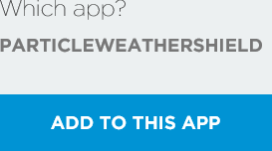
Add the Weather Shield library
In the Particle Build web interface, click the “Libraries” icon
Search for the SparkFun_Photon_Weather_Shield_Library
Select it, and then click the “INCLUDE IN APP” button:
Then, select the “ParticleWeatherShield” app, and click the “ADD TO THIS APP” button

Slide 36
Library include and fields
// This #include statement was automatically added by the Particle IDE.
#include "SparkFun_Photon_Weather_Shield_Library/SparkFun_Photon_Weather_Shield_Library.h"
Weather sensor;
char Org[] = "WearHacks LA";
char Disp[] = "Brets Demo Photon";
char Locn[] = "LA";

Slide 37
Library include and fields
// This #include statement was automatically added by the Particle IDE.
#include "SparkFun_Photon_Weather_Shield_Library/SparkFun_Photon_Weather_Shield_Library.h"
char Org[] = "ORGANIZATION_NAME";
char Disp[] = "DISPLAY_NAME";
char Locn[] = "LOCATION";
//Create Instance of the Weather Shield
Weather sensor;
//The amount of time (in milliseconds) to wait between each publication of data
int sendDelay = 6000;

Slide 38
Setup method
void setup()
{
//Open up the Serial port for local diagnostics
Serial.begin(9600);
//Initialize the I2C sensors and ping them
sensor.begin();

Slide 39
Setup method
//The following two lines tell the sensor what mode to use
sensor.setModeBarometer();//Set to Barometer Mode
//These are additional MPL3115A2 functions the MUST be called for the sensor to work.
sensor.setOversampleRate(7);
//Give the sensors some time to initialize
delay(10000);
}

Slide 40
Loop method, and sensor reading
void loop()
{
//Measure Relative Humidity from the HTU21D or Si7021
float h = sensor.getRH();
//Measure Temperature from the HTU21D or Si7021
float f = sensor.getTempF();

Slide 41
Publish temperature data
// Generate the temperature data payload
char payload[255];
snprintf(payload, sizeof(payload), "{\"s\":\"Weather\", \"u\":\"F\", \"m\":\"Temperature\", \"v\": %f, \"o\":\"%s\", \"d\":\"%s\", \"l\":\"%s\"}", f,Org,Disp,Locn);
//Emit the payload to the serial port for monitoring purposes
Serial.println(payload);
// Send the temperature data payload
Particle.publish(“ConnectTheDots", payload);
//Wait for the specified "sendDelay" before sending the humidity data...
delay(sendDelay);
{
“s”: “Weather”,
“u”: “F”,
“m”: “Temperature”,
“v”: 79.234,
“o”: “ORGANIZATION_NAME”,
“d”: “DISPLAY_NAME” “l”: “LOCATION”,
}

Slide 42
Groking the photon code
// Generate the humidity data payload
snprintf(payload, sizeof(payload), "{\"s\":\"Weather\", \"u\":\"%%\", \"m\":\"Humidity\", \"v\": %f, \"o\":\"%s\", \"d\":\"%s\", \"l\":\"%s\"}", h,Org,Disp,Locn);
// Emit the payload to the serial port for monitoring purposes
Serial.println(payload);
// Send the humidity data payload
Particle.publish(“ConnectTheDots", payload);
// wait for the specified "sendDelay" before looping...
delay(sendDelay); } // End of loop()
{
“s”: “Weather”,
“u”: “%”,
“m”: “Humidity”,
“v”: 25.345,
“o”: “ORGANIZATION_NAME”,
“d”: “DISPLAY_NAME” “l”: “LOCATION”,
}

Slide 43
Modify the metadata properties
Put your own values in. Make sure that the “Display Name” is appropriate and identifies your Photon clearly: char Org[] = "ORGANIZATION_NAME"; char Disp[] = "DISPLAY_NAME"; char Locn[] = "LOCATION";

Slide 44



Save, verify and flash
Click the save icon to save your sketch:
Click the verify icon to compile and verify:
Click the flash icon to deploy your sketch:

Slide 45
Monitoring your photon

Slide 46
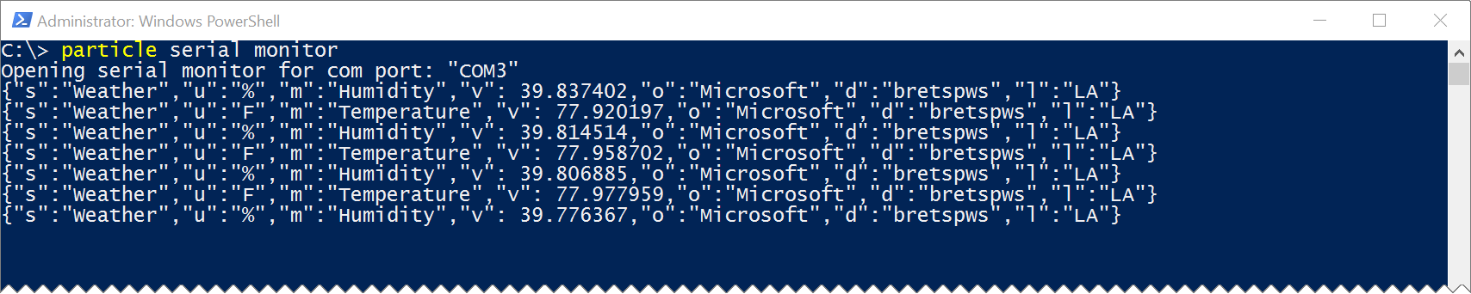
Monitoring photon via serial
particle serial monitor

Slide 47
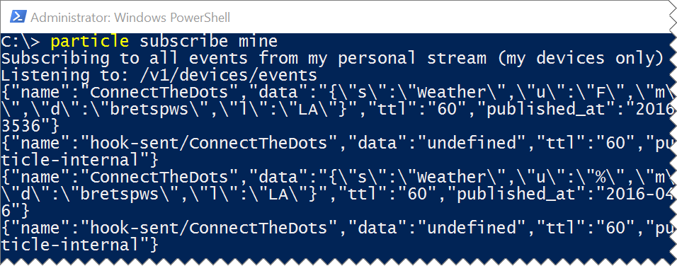
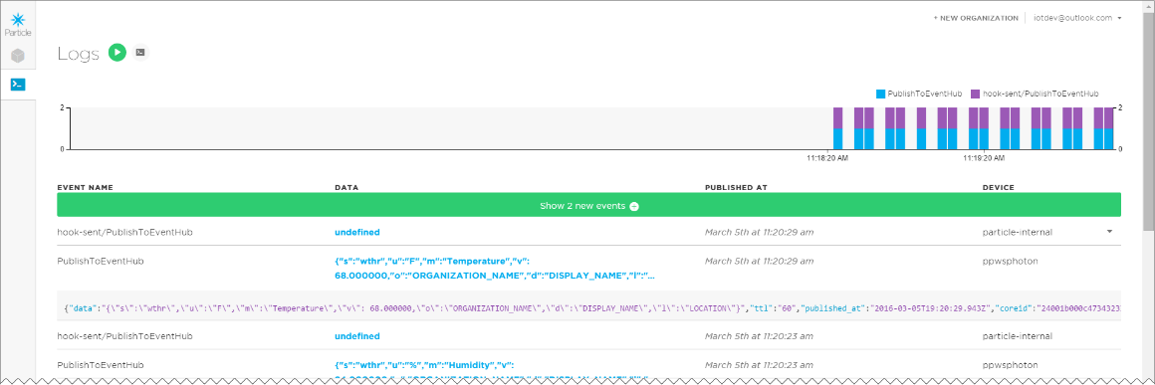
Monitoring webhook
Particle-cli: particle subscribe mine
Particle Dashboard: http://dashboard.particle.io/user/logs

Slide 48
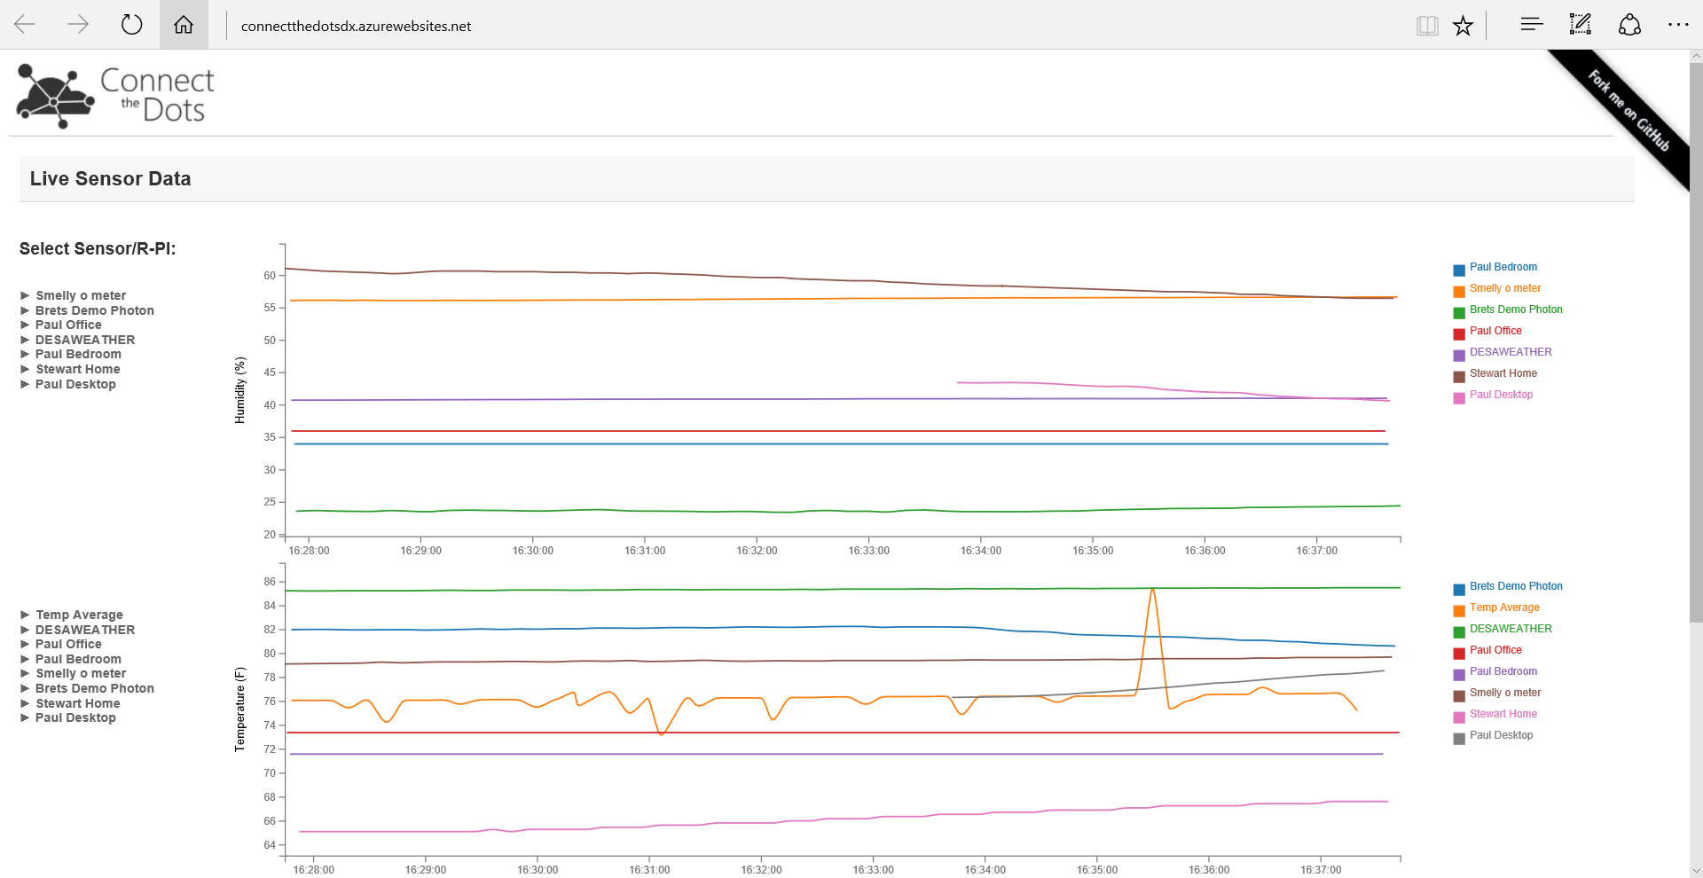
Monitor via the web
http://aka.ms/pwsholweb
Click device names along the left to show or hide them in the graphs

Slide 49
Where to go from here?
Publish other sensor values. There are TON’s of other sensors you can use. As an example, check out: http://aka.ms/sparkfunsensors
Don’t want to use Paul’s existing event hub & web site? Make your own event hub and publish to Power BI, or consume the data from a client app! Check out my step by step walkthrough at: http://aka.ms/ppws
Don’t want to be limited by the Particle Cloud’s rate limits? Try publishing to your own API: http://aka.ms/iotree

Slide 50
resources:
This deck, and other event resources: http://aka.ms/whla
Info about Particle and Azure: https://www.particle.io/microsoft
Azure Documentation http://azure.microsoft.com
Azure Portal https://manage.windowsazure.com and https://portal.azure.com
Particle Documentation http://docs.particle.io

Slide 51
IoT Logo

Slide 52
arduino

Slide 53
GALILEO BOARD

Slide 54
LEDs

Slide 55
Resistors
220Ω
1st Digit
2nd Digit
Multiplier
Tolerance
Color | Name | 1st Digit | 2nd Digit | Multiplier | Tolerance
 | Black | 0 | 0 | X1
 | Brown | 1 | 1 | X10 | 1%
 | Red | 2 | 2 | X100
 | Orange | 3 | 3 | X1,000
 | Yellow | 4 | 4 | X10,000
 | Green | 5 | 5 | X100,000
 | Blue | 6 | 6 | X1,000,000
 | Violet | 7 | 7
 | Grey | 8 | 8
 | White | 9 | 9
 | Gold |  |  | X0.1 | 5%
 | Silver |  |  | X0.01 | 10%
330Ω
10KΩ

Slide 56
cables

Slide 59
Micro SD Cards
Font: Segoe UI Semibold

